Slide 1
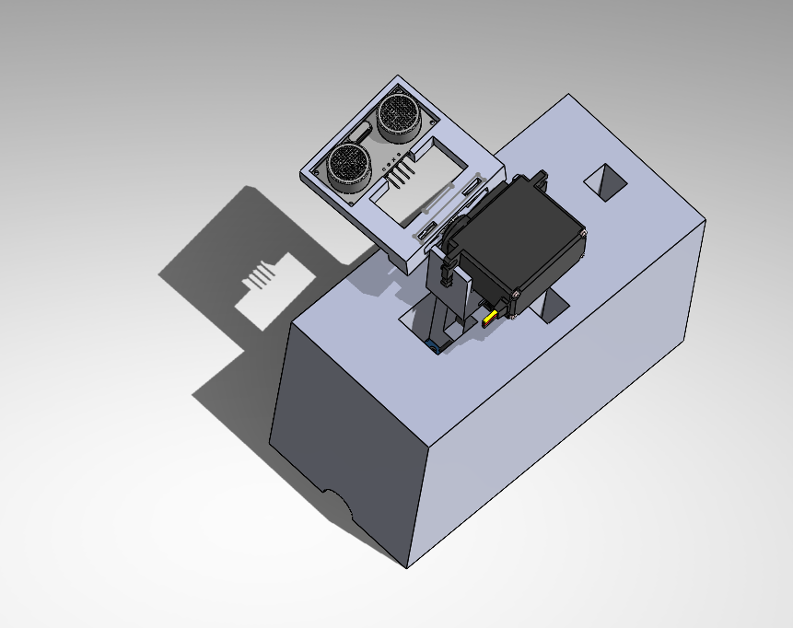
SoNAR Drone Defensive Detection in 3D Spaces (SoDDD 3DS)
For:NREIP By: Matthew Sieger

Slide 2


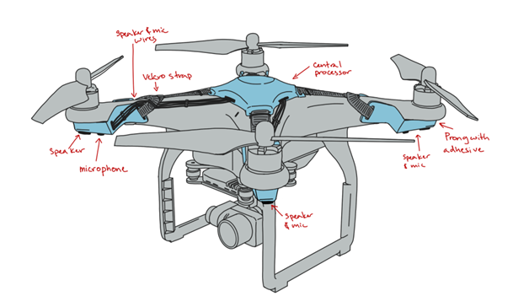



Introduction (Me)
Cal Poly Pomona - Aerospace Engineering
Senior Standing - 3.96 GPA
NASA Proposal - Drone Active Noise Cancellation in Noise-Polluted Geographies
Soups - 30 Countries

Slide 3
Program Objectives
Blue Team Objectives | My Objectives
1. Detect enemy drones reliably and quickly without unfair false positives | 1. Make a SoNAR system with less than 5% false positives
2. Be able to detect them in the widest area possible | 2. Increase the scan from 15 degrees to 180

Slide 4
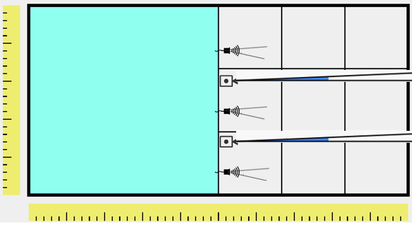
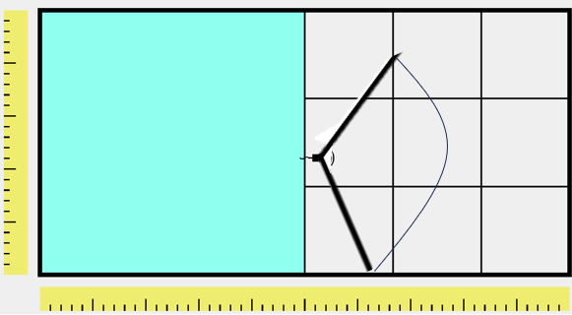
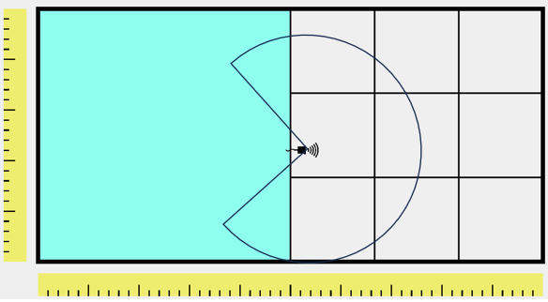
Needs Analysis
Red Team must Protect Their Airspace
Old System: 4ft range, 15 degrees
SoDD 2DS: 12.5ft range, 120 degrees
SoDD 3DS: 12.5ft range, ¾ dome
Old
SoDD 2DS
SoDDD 3DS

Slide 5

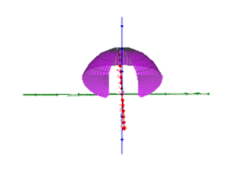
SoDDD 3DS
¾ Dome will encompass a snow cone-like shape

Slide 6
System Candidate Architectures Faceoff
Architecture | Scan Sweep (Improvement) | Range | Baselines/Maps | Error % | Error dependent on Setup?
Non-Rotating Sensor | 15 degrees (x1) | 4ft | 0 | 0-50 | Yes
SoDD 2DS | 130 degrees (12x) | 12.5ft (x3.25) | 48 | 0.3-.6% | No
SoDDD 3DS | ¾ Dome (108x) | 12.5ft (x3.25) | 4 | 0.6-5% | No

Slide 7

Utilization Requirements / Setup
Lay box flat on a surface
Find the (x,y) coordinates of it in your cage
Power
Servos move to their rotations = 0
Note horizontal rotation in reference to a marked wall on the GUI
Note vertical rotation if sensor is not pointing straight up towards the ceiling

Slide 8
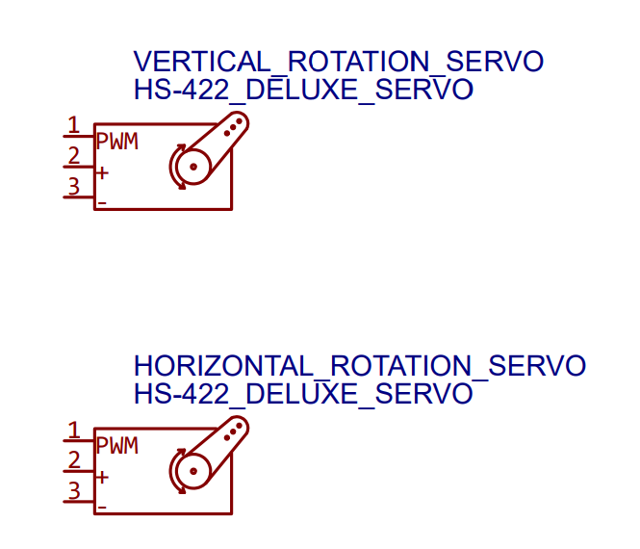
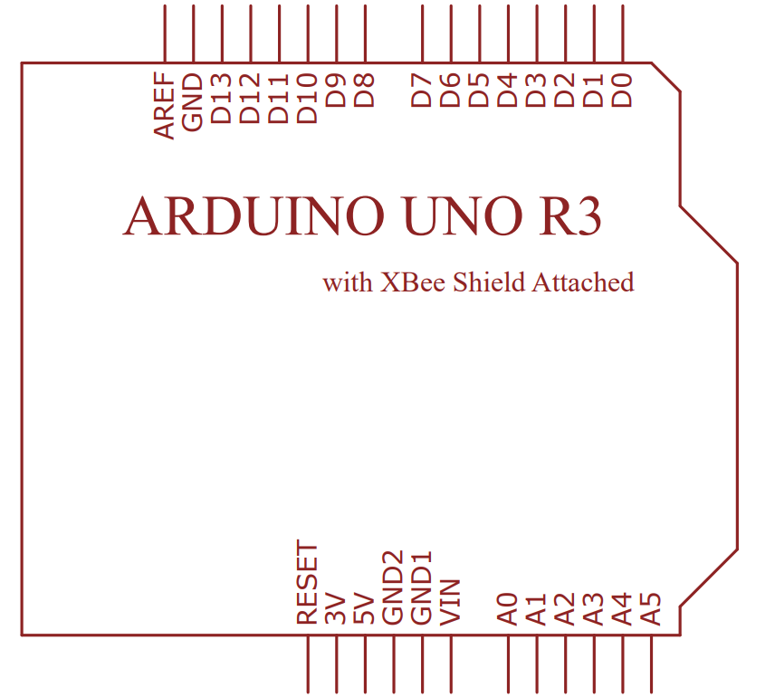
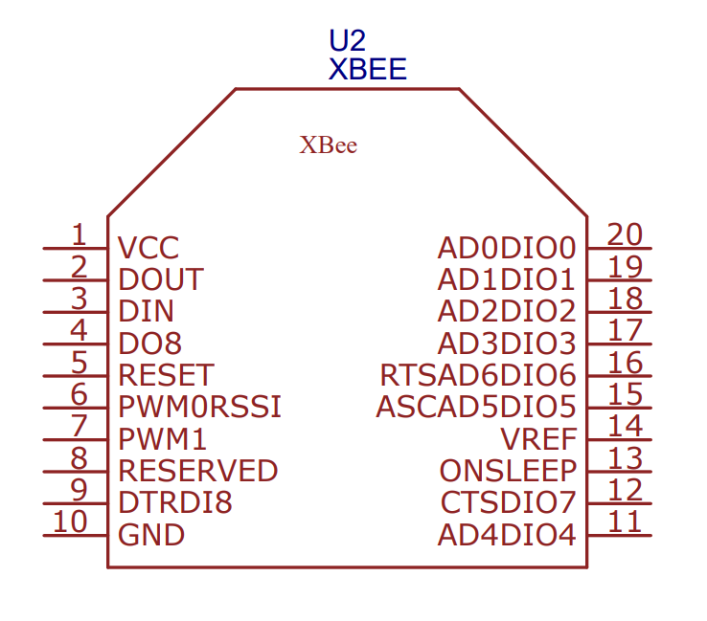
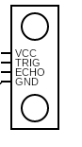
Wiring Diagram

Slide 9
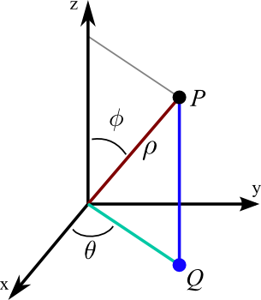
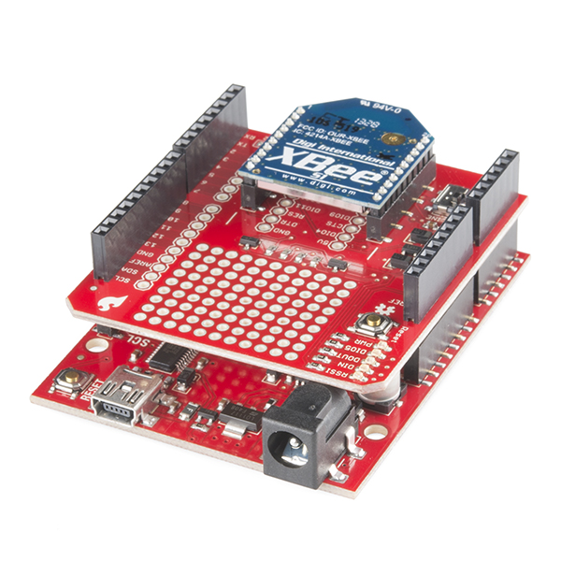
How it Works
2 Servos + 1 Ultrasonic + XBee
Servo1- Horizontal Rotation (θ)
Servo2- Vertical Rotation (ϕ)
Ultrasonic- Distance (ρ)
XBee- Communicate via Zigbee

Slide 10
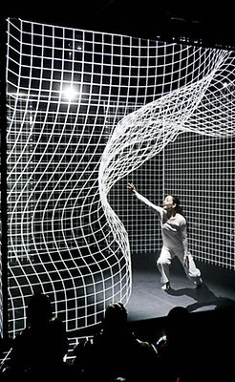
Mapping Aspect
Baseline maps
13x13, with a purpose!
2D vs. 3D
Deviations

Slide 11
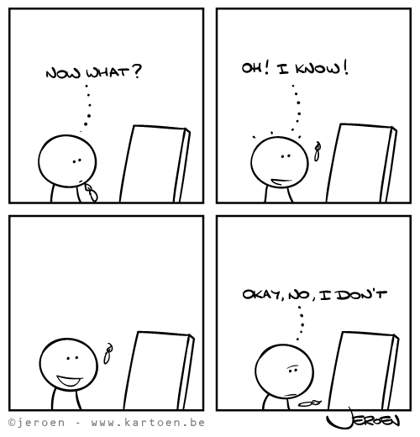
False Positives
Previously, no filter
notTooFar
deviatesEnough
Distance>12.5 ft
Distance=0
Serial.print error - Suppression

Slide 12
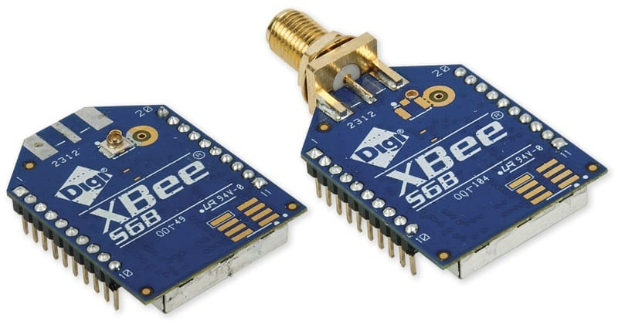
Expectations Shattered
XCTU errors - Switched from MATLAB to C++
Servo library and Xbee clash
Servo only moves 130 degrees – invent oneRealDegree

Slide 13
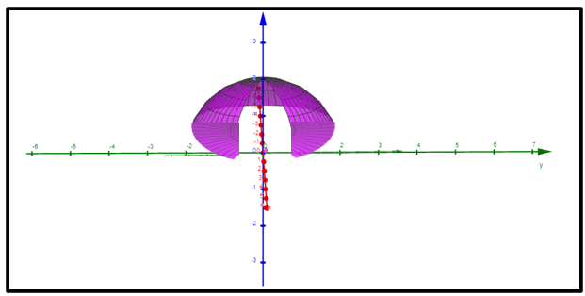
Calculations for Position
Degree increments * rows and columns
Centering: iRotation - (180 – servoMaxDegrees)/2
Servos go from 0-180, but real world is -90 to 90 for both.
90-iRotation=Actual Rotation
If phi <0, phi= -phi & theta=theta+180 degree

Slide 14
Summary

